Slide 1





Ramazan POYRAZ 0602070..
Mehmet ÇELİK 060207037
H. Onur ÇELİK 060207021
Selçuk ÜNALAN 060207031

Slide 2

Investment banking firm performs two general functions:
To assist in obtaining funds for the capital seekers.
To act as a brokers or dealer for the capital provider.

Slide 3


Commercial banks
Security firms

Slide 4

Investment banking generates revenue from commission, fee income. Spread income, and principal activities. Specifically, these activities can be classified as follows
Public offering (underwriting ) of securities
Trading of securities
Private placement of securities
Securitization of assets
Merger and acquisition
Merchant banking
Trading and creation of derivate instrument
Money management

Slide 5


The traditional role associated with investment banking is underwriting of securities. The traditional process in U.S for issuing in new securities involves investment bankers performing one or more of following three functions.
Advising the issuer on the terms and the timing of the offering
Buying the securities from the issuer
Distributing the issue to public

Slide 6

In the sale of new securities, investment bankers need not to undertake the second function of buying the securities from the issuer. An investment banker may merely act as an advisor and/or distributor of the new security.

Slide 7


Buying the securities from the issuer is called underwriting.
When an investment banking firms buys the securities from issuer and accepts the risk of selling securities to investor at a lower price, it is referred underwriter.

Slide 8
When an investment banking firms agrees to buy securities from the issuer at a set price, the underwriting arrangement is referred to as a firm commitment.
Best effort underwriting arrangement investment banking firms agrees only to use expertise to sell the securities; it does not buy the entire issue from issuer.

Slide 9
The fee earned from underwriting securities is the difference between the price paid to the issuer and the price at which the investment bank re offers the security to public. This difference is called gross spread or the underwriter discount.
To share losing capital risk, investment banking firm puts together a group of firm to underwrite the issue. This group of firm is called underwriting syndicate. This syndicate includes two group lead underwriter and other firms.
To increase the potential investor base, the lead underwriter puts together a selling group.
Selling group includes the underwriter syndicate plus other firms not in the syndicate.
Members of selling groups can buy the security at a concession price.
Investment bankers also may assist in offering the securities of government-owned companies to private investors. This process is referred to as privatization.

Slide 10

It would be a mistake to think that once the securities are all sold the investment banking firm’s ties with the deal are ended.
In the case of bonds, those who bought the securities will look to the investment banking firm to make a market in the issue.
The investment banking firm must be willing to take a principal position in secondary market transactions.
Revenue from this activity is generated through:

Slide 11
The difference between the price at which the investment banking firm sells the security and the price paid for the securities.
Appreciation of the price of securities held in inventory. Obviously, if the securities depreciate in price, revenue will also be reduced.

Slide 12




To protect against a loss, investment banks engage in hedging strategies.
Various strategies are employed by traders to generate revenue from position in one or more securities:
Riskless arbitrage
Risk arbitrage
Speculation

Slide 13



The act of buying an asset and immediately selling the same asset for a higher price. The short time frame involved means that riskless arbitrage occurs without investment; there is no rate of return or anything like it because the asset is immediately sold. One simply makes a profit on the deal.
Profiting from price differences when the same asset is traded in different markets.

Slide 14

For example, an arbitrageur simultaneously buys one contract of silver in the Chicago market and sells one contract of silver at a different price in the New York market, locking in a profit if the selling price is higher than the buying price..
It is also the process of selling overvalued and buying undervalued assets so as to bring about an equilibrium where all assets are properly valued

Slide 15
In case of a security priced in a foreign currency, the price must be converted based on the exchange rate.
The key point is that a riskless arbitrage transaction does not expose the investor to any adverse movement in the market price of the securities in the transaction.

Slide 16

A form of arbitrage which involves the simultaneous purchase of shares in one company and the short sale of assets in another. This strategy is typically used in expectation of a pending announcement of a take-over by a company. By purchasing shares in the company that is expected to be taken over and selling short shares in the acquiring company, an investor hopes to gain from both sides of the trade. Risk arbitrage may also be used in situations involving tender offers or reorganizations. Also called equity arbitrage.

Slide 17

Firm A may make an offer to acquire Firm B by exchanging one share of its own stock for two shares of Firm B's stock. If the stock of Firm A is trading at $50 and the stock of Firm B is trading at $23, the risk arbitrager would buy shares in Firm B and sell short one-half this number of shares in Firm A. If the buyout offer is, the two stocks will exchange on a one-for-two basis and the arbitrage position will be profitable. The risk is that the buyout will be unsuccessful and the exchange of stock will not take place.

Slide 18

The selling of a security that the seller does not own, or any sale that is completed by the delivery of a security borrowed by the seller. Short sellers assume that they will be able to buy the stock at a lower amount than the price at which they sold short. This is an advanced trading strategy with many unique risks and pitfalls. Novice investors are advised to avoid short sales.

Slide 19

For example, an investor who borrows shares of stock from a broker and sells them on the open market is said to have a short position in the stock. The investor must eventually return the borrowed stock by buying it back from the open market. If the stock falls in price, the investor buys it for less than he or she sold it, thus making a profit.
For example, selling a call (or put) options contract to a buyer entitles the buyer the right, not the obligation to buy from (or sell to) you a specific commodity or asset for a specified amount at a specified date.

Slide 20


..occurs when trader position the capital of the investment banking firm to take advantage of a specific anticipated movement of prices or spread between two prices.

Slide 21

The completion of a buy or sell order for a security. The execution of an order happens when it is completely filled, not when it is placed by the investor. When the investor places the trade, it goes to a broker, who then determines the best way for it to be executed.

Slide 22


To encourage clients to use a firm to execute transaction so that commissions or bid-ask spread income can be generated, investment banks provide research for clients.

Slide 23

investment banking is underwriting securities for distribution to the public.
investment banking firms place securities with a limited number of institutional investors such as insurance companies ,investment companies and pension funds.

Slide 24
the fees for arranging a private placement vary depending on the issuance amount and the complexity of the transaction moreover in raising venture capital for clients investment bankers are frequently offered the opportunity to share in the prosperity of the company

Slide 25

securitization of home mortgage loans to create mortgage-backed securities was the first example of the process.
securities backed by a pool of loans or receivables are called asset-backed securities
when an investment banker works with a corporation to issue an asset-backed security it generates revenue from the bid-ask spread in the sale of the security

Slide 26
when an investment banker buys loan and receivables and then issues securities ,it generates a profit on an asset-backed security transaction as follows; the differences between the price the security is sold for minus the price it paid to purchase to collateral minus the interest cost of "warehousing" the collateral purchased until the securities are sold.

Slide 27


investment banking firms are active in mergers and acquisition. Under mergers and acquisition activity are also included leveraged buyouts , restructuring and recapitalization of companies , and reorganization of bankrupt and troubled companies.

Slide 28
Investment bankers may participate in M&A activity in one of several ways (1)finding M&A candidates , (2) advising acquiring companies or target companies with respect to price and nonprice terms of an exchange ,or helping target companies fend of an unfriendly takeover attempt , and (3) assisting acquiring companies in obtaining the necessary funds to finance a purchase .

Slide 29
The fee structure in this case can be of three types (1) percentage can decline the higher the selling price or (3) the percentage can be fixed with addition of a incentive fee if the price better than a specified amount.
An investment banking firm can earn fees from (1) proposing the acquisition (2) arranging the financing (3) arranging bridge financial and (4) other advisory fees.

Slide 30

Merchant banking invest the firm’s own capital as well as funds raised from outside investors in companies and real estate.
When an investment banking firm commits its own funds by either taking an equity interest or creditor position in companies, this activity is referred to as merchant banking.

Slide 31
An examples is bridge financing where in an investment banking firm loan s funds to a client to consummate a takeover. Bridge financing is not only important for its potential source of interest income, but also to attract clients who are considering an LBO. Examples, risk of bridge financing:
First Boston Corporation’s bridge loan of $450 million to Ohio Mattress Co. to finance an LBO. After the LBO was completed and Ohio Mattress could not get permanent financing. First Boston was stuck with the bridge loan.
Another examples is project financing: funding provides by a syndicate of a merchant banks. Claim is only to the revenue from the project itself, not to the rest of revenues and assets of firms taking on project. Such as new airport project, MTR project.

Slide 32

Examples of contracts that can be used to control risk both investors and issuers include futures, options, interest rate swaps and customized interest rate agreements.
Commissions are generate from the exchange traded instruments that customers buy and sell thought investment banking firms.
There are risk control instruments which an investment banking firm creates for its clients and in which it acts as a counterparty to the agreement. These are called over-the-counter or dealer-created risk instruments.
For examples, in an interest rate swap, the parties to the agreement exchange cash payments to one another based on movements in specified market interest rates.

Slide 33
Banks frequently act as middleman in swap transactions by serving as a counterparty to both sides of the transaction.
Risk control instruments are also used by investment banking firms to protect their own position in transactions.

Slide 34

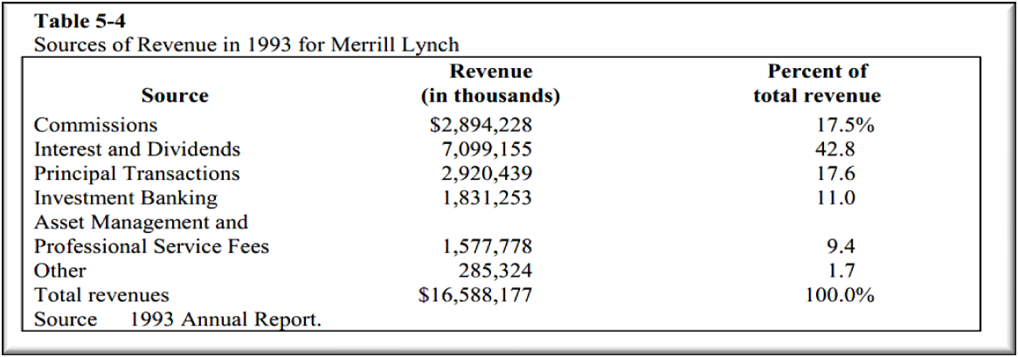
Investment banking firms create subsidiaries that manage funds for either individual investors or institutional investors such as pension funds. Money management activities generate fee income based on a percentage of the assets under management. Examples of investment revenue.

Slide 35



